Slide 1
Machine Learning

Slide 2
What is machine Learning?
Machine learning is the field of study that gives the computer the ability to learn without being explicitly programmed.
-Arthur Samuel

Slide 3
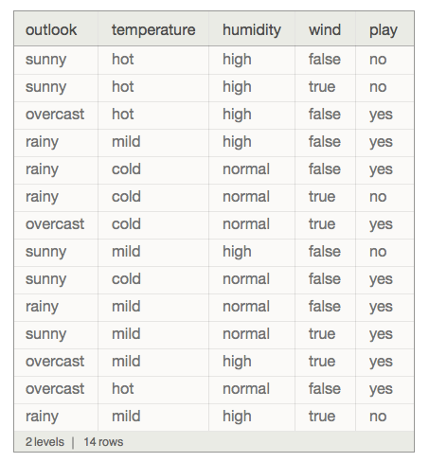
What is a dataset?
A collection of data is called dataset.
It is mostly in the form of text and images.

Slide 4
Preprocessing - IMPUTING
The dataset should not contain any missing values, The missing values in dataset should be processed in order to proceed further.
Class | Group 1 | Group 2
Class 1 | 82 | 95
Class 2 |  | 88
Class 3 | 84

Slide 5

Replacing The Missing Values
Mean
Median
Most Frequent

Slide 6
Processing Categorical Data
Country(Categorical) | Country(Numerical)
GERMANY | 1
FRANCE | 0
ITALY | 2
Mathematical algorithms will not work under categorical data. They must be encoded into some numerical form to proceed further.

Slide 7
TYPES of Machine learning
Supervised Learning.
Unsupervised Learning.
Semi supervised Learning.
Reinforcement Learning.

Slide 8
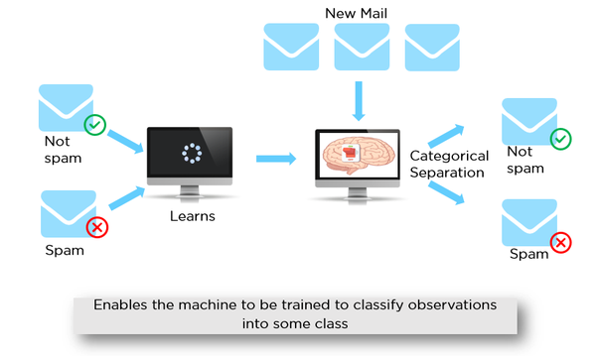
Supervised Machine Learning
In supervised machine learning the training data will contain desired outputs. A typical example would be a spam filter.

Slide 9
Add a Slide Title - 4

Slide 10
Add a Slide Title - 5

